Slide 1
Instruction cycle

Slide 2
Instruction Cycle
- processing required for a single instruction
Instruction cycle:
- Fetch cycle
- Execute cycle
Execute cycle has following action:
- Processor- memory
- Processor –I/O
- Data Processing
- Control

Slide 3

Instruction Cycle
The IAS operates repetitively performing an instruction cycle.
Each instruction cycle consists of Two subcycles.
Two steps:
  Fetch
  Execute

Slide 4
Fetch Cycle
Program Counter (PC) holds address of next instruction to fetch
Processor fetches instruction from memory location pointed to by PC
Increment PC
  Unless told otherwise
Instruction loaded into Instruction Register (IR)
Processor interprets instruction and performs required actions

Slide 5
Execute Cycle
Processor-memory
  data transfer between CPU and main memory
Processor I/O
  Data transfer between CPU and I/O module
Data processing
  Some arithmetic or logical operation on data
Control
  Alteration of sequence of operations
  e.g. jump
Combination of above

Slide 6
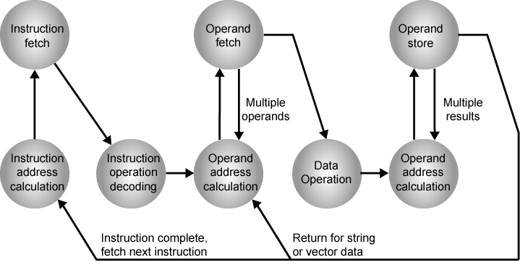
Instruction Cycle State Diagram

Slide 7
Instruction state cycle diagram (cont..)
Instruction address calculation (iac):
  Determine the address of the next instruction to be executed. Adding a fixed number to a next number.
Instruction fetch: (if)
  Read the instruction from its memory location into the processor.
Instruction operation decoding: (iod)
  Analyze instruction to determine type of operation to be performed and operand(s) to be used.
Operand Address Calculation: (oac)
  If the operation involves the reference to an operand in memory or available via I/O, then determine the address of the operand.
Operand Fetch (of):
  Fetch the operand from memory or read it from I/O.
Data Operation (do):
  Perform the operation indicated in the instruction.
Operand store (os)
  Write the result into memory or out to I/O.

Slide 8
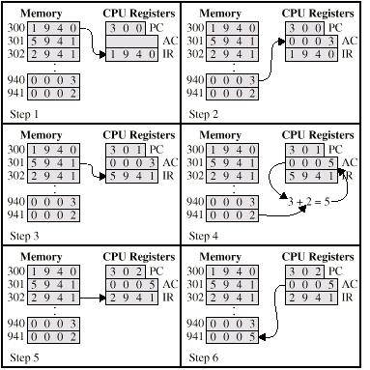

Example of Program Execution

